Slide 1


Agenda
Introduction of use cases in CRITISEC
Presentation: Sensative, Yggio
Presentation: Applio, Sense
Use case: Energy Distribution.
Anomaly detection in IoT Networks, focus energy distribution
Scale up use case: Smart City
Security in large IoT Deployment like a Smart City
Andreas Ohlsson
Håkan Lundström

Slide 2
Critisec use cases

Slide 3
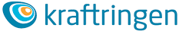
Use case - Energy Distribution
Kraftringen – Energy company
Infrastructure for electricity, gas, district heating and cooling, communication
Serves about 280 000 customers in south Sweden
CritiSec scope - Increase monitoring and control with IoT
Sensors connected by sensor networks and open IoT-platform
Lower cost than existing solutions
Benefits
Improved quality – reduce power failures and outage time for customers
Improved efficiency – from scheduled to event-based maintenance
But it has to be secure, robust and resilient… Classified as
Security sensitive business (Protective Security Act)
Societal critical business (Authority for social protection and emergency preparedness)

Slide 4
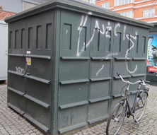
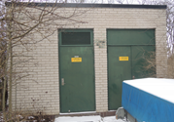
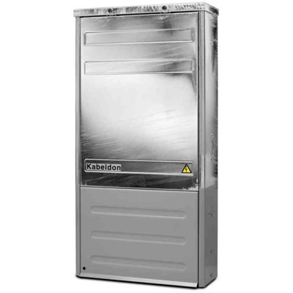
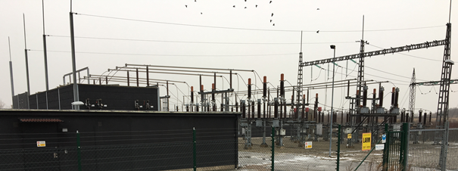


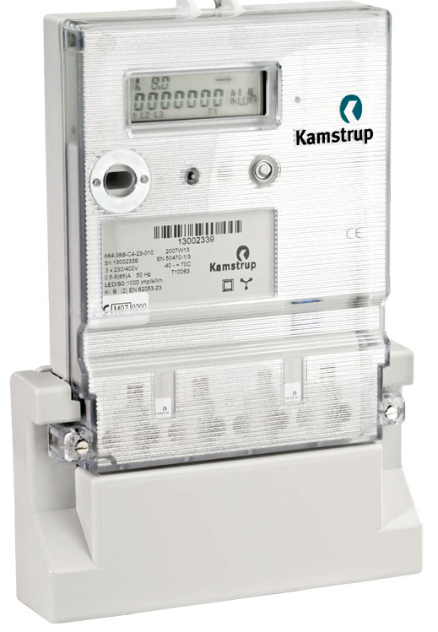
Use case - Energy Distribution
Electricity cabinets (16 000 pcs.)
Main station (60 pcs.)
FAILURE
Substations (2 700 pcs.)
At a power failure
Time to find failure is crucial for the outage time
Electricity meters (100 000 pcs.)

Slide 5

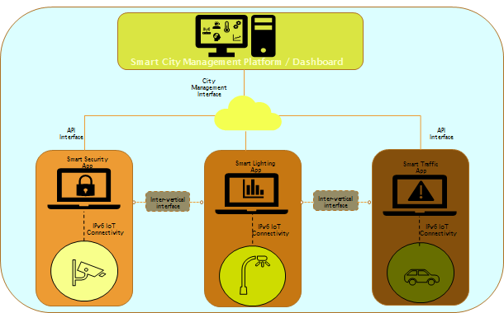
Use case – Smart City
Open IoT smart city platform
Deploying a managed street lighting system with wireless motion sensors based on 6LoWPAN
Integrating street lighting system in a smart city open, horizontal platform
Integrating environmental wireless sensors based on LoRa
Enabling open smart city platform through a common API model
Developing a prototype of a comprehensive security solution using ETSI standard _ FIWARE APIs and data format
Focus on managed street lighting system

Slide 6
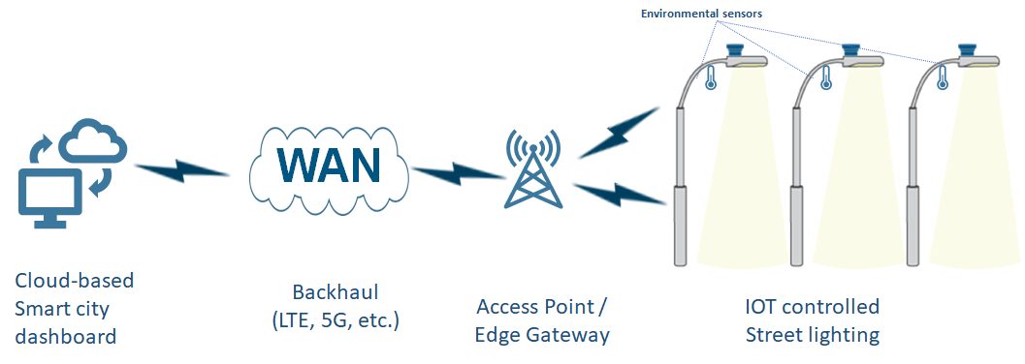
Use case – Smart City
6LoWPAN smart lighting connectivity

Slide 7


YGGIO DiMS
Digitalization infrastructure Management System
Notes:
Customer owns and controls all data

Slide 8

ABOUT SENSATIVE
SENSATIVE STRIPS
Technology made simple
Install & forget (10 years battery life)
Ultra thin design
Indoor and outdoor use
Founded in 2013 to make IoT easy and usable.
Sensative connects people and services to the physical world of cities, buildings, homes, and more.
STRIPS – Smart sensor family for digitizing real world
YGGIO – Advanced IoT Integration platform for connecting to services and digital twins
Technology made simple. Technology that makes sense.
SENSATIVE YGGIO
One open API to the real world
Technology neutral LIVE data
Horizontally integrated IoT management
Multiple sensors shared between multiple services and users

Slide 9
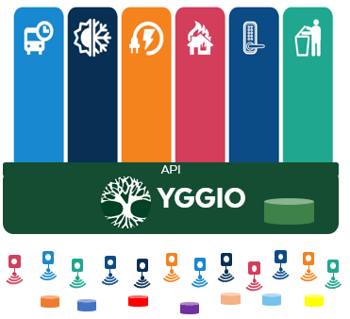


Yggio - DiMS
Digitalization powered by Yggio
A common DiMS for the digitalization
Owned and managed by the business owner
Supporting standard open API & Data models to normalize incoming data.
Scalable, secure, robust, resilient and portable by using state of the art technologies.
Deploy at edge or in cloud.
An ecosystem of 3rd party Service Providers and partner creating value for employees, customers, tenants, citizens, partners and more
YGGIO
The common digitalization platform for any smart domain
Data-driven services
Common
Platform
Sensors, devices & data sources
Standardised open APIs, like FIWARE, minimize vendor lock in effects.

Slide 10



Slide 11
ABOUT APPLIO TECH
Founded in 1993 as Q2D Solutions. Specialized in business-critical processes in large companies with customers as Sony Ericsson, Tetra Pak and Volvo.
Started with development of IoT Security solutions in 2015.
New owner and new company name in 2020.
Released Applio Sense and Applio Free as commercial products in 2021.
Applio Sense
An IoT Security management platform designed for both cloud and on-premise
Centralized device and security lifecycle management
Monitor all IoT-networks in a organization
Insights and alarms in large IoT deployments
Applio Free
A simple and free to use IoT platform
Supports end-to-end IoT-solutions built on LoRa
Designed for fast development of small IoT applications

Slide 12
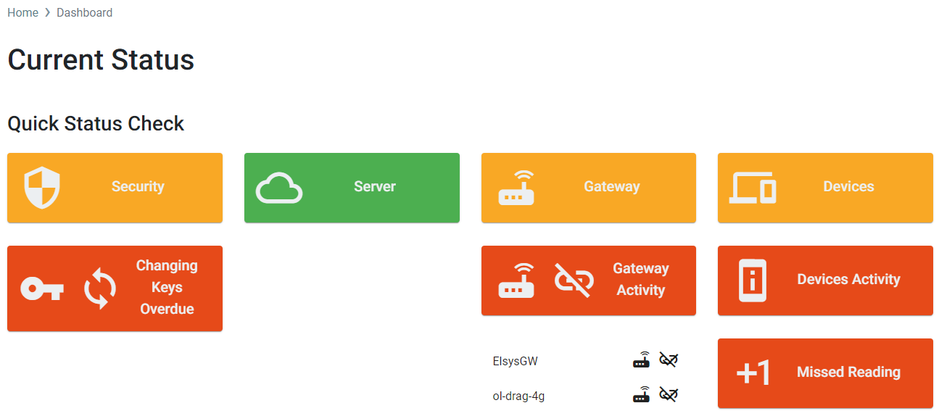
Applio Sense
Device Lifecycle Management
Onboarding – deploy devices – one by one or as batch
Monitoring – keep track that devices are working as expected
Keep a log on each device
Manage manufacturer, hardware- and software versions
Put devices into an organizational context (hierarchy)
Security configuration management
Removal – take devices out of service
IoT Insights
Dashboard – Radio quality, security management, device and Infrastructure anomalies
Alarms – Logs and escalating of incidents
Quality summary of device manufacturers and models
Insights as data source can be utilized in organization´s IoT Server (like Yggio)

Slide 13

Use Case - Energy Distribution

Slide 14

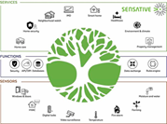


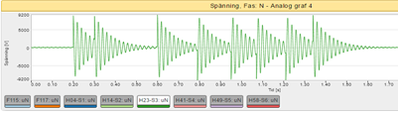
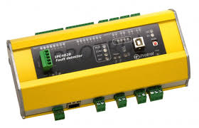




Use case - Energy Distribution
Yggio - DiMS
Act
E2E Security feasible
”SCADA”
Analyze
Collect
SCADA
NIS
…
Power failure
Where and why?
Today
Sense
Anomaly detection

Slide 15


Quality control of energy cards
Analyze energy distribution status
2
Oauth 2.0
+ FIWARE NGSI subscription
Oauth 2.0
+ FIWARE NGSI subscription
Generic Yggio HTTPS IoT-node.
Add analyze result to data stream
3
Yggio is powered by RATATOSK. The FIWARE NGSI compliant publish/ subscribe context broker.
Enforce zero trust access.
1
4
Oauth 2.0
HTTPS Yggio Rest API
FIWARE NGSI subscription
YGGIO
”SCADA”
SCADA
NIS
…
AES128 encryption
Oauth 2.0
FIWARE NGSI subscription
Yggio Access and Identity management
Energy measurement
Air quality / Access Security
5
LoRa network monitoring
to detect anomalies
Sense

Slide 16
Yggio is powered by RATATOSK. The FIWARE NGSI compliant publish/ subscribe context broker.
Enforce zero trust access.
1
Extra security can be achieved by placing the LoRa join server (or full LoRa server) inside energy providers intranet.
YGGIO
AES128 encryption
Oauth 2.0
FIWARE NGSI subscription
Yggio Access and Identity management
Energy measurement
Air quality / Access Security
5
LoRa network monitoring
to detect anomalies
Sense

Slide 17

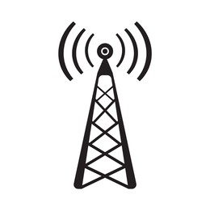
Anomaly detection in IoT Network
Anomalies for a single device: radio quality or complete offline
Anomalies for all devices with traffic through a specific base station: radio quality or complete offline
Sensor data may be insufficient for IoT Application
IoT Server
IoT Application (i.e. Scada)
Fake or tampered device
Anomalies for a single devices: instable behavior as multiple reboots, low battery
Sensor data may be insufficient for IoT Application
Anomalies for a single device: device is not to be trusted anymore
Sensor data must not be used in IoT Application

Slide 18
Use case – Smart City
Smart lighting control
for pedestrian, bicycle lanes, parks and small streets

Slide 19

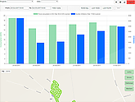
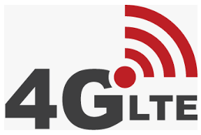

Use case – Smart City
Street lighting Cloud solution
2
Yggio is powered by RATATOSK. The FIWARE NGSI compliant publish/ subscribe context broker.
Enforce zero trust acess.
1
Smart luminares (Street lighting)
Between luminaries 6LoWPAN, to cloud 4G LTE
Street lighting integration
with FIWARE NGSI API and Dataformat
Two-way communication
Security integration feasible
3
Smart City Vertical services
IoT sensors
4
(arbitrary protocol feasible)
YGGIO - DiMS

Slide 20
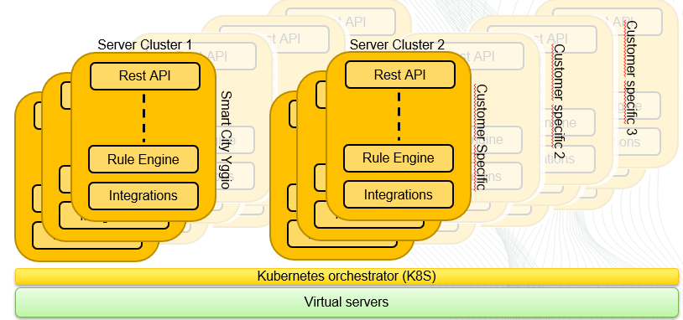
Use case – Smart City
Scale up - Yggio DiMS benefits:
Performance through horizontal scaling
Robustness and resilience (multiple instances of every service)
Access engine tuned for maximum performance (data models response time verified with 1 000 000 devices with 10 000 user account in just one server)
Yggio is powered by RATATOSK. The FIWARE NGSI compliant publish/ subscribe context broker.
Enforce zero trust acess.

Slide 21
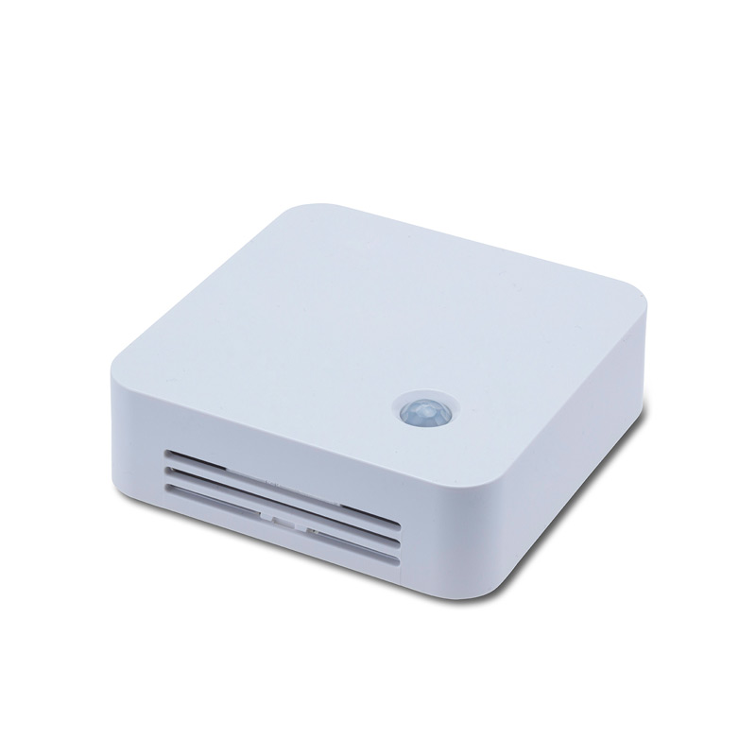
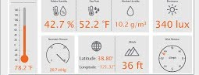
Security in large scale IoT deployments
IoT Application
Sensor
Connection security
with each stack
IoT Infrastructure
Cloud based with open Rest APIs
HTTP Security with TLS
LTE or LORA
Access control
(OAUTH 2)
E2E Security with OSCORE
Protect sensible data with an extra layer of security
Sensor data can be kept encrypted between ends (device and UI)
Open and protected sensor data/devices can be managed in the same system
Different IoT applications can have various access levels
Different users of IoT applications can have various permissions

Slide 22
Thank you

